Slide 1
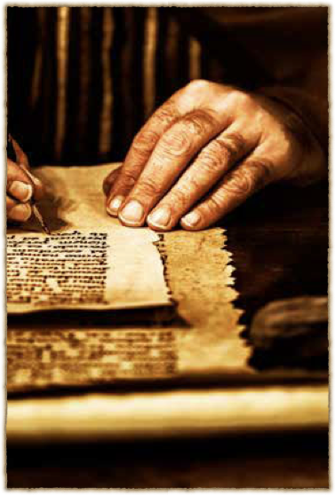
Theme
Guard the gospel
Emphasis on role of Scriptures

Slide 2
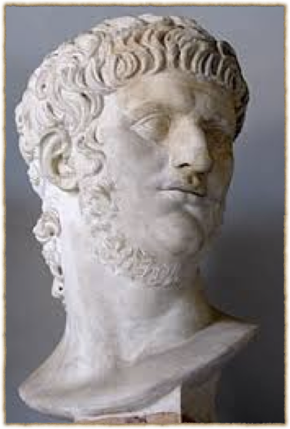
Context
Very personal letter
Paul felt abandoned by some
Cared for by Onesiphorus

Slide 3
The exhortation
Be strong in the grace that is in Christ Jesus.

Slide 4
Teach the truth to other faithful men

Slide 5
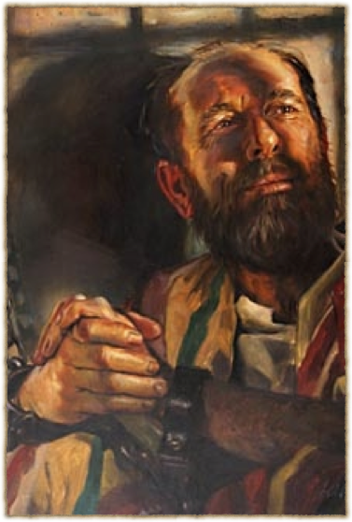
Endure hardship

Slide 6
…the soldier

Slide 7
…the athlete

Slide 8
The crown of righteousness
2 Tim. 4:8

Slide 9
…the Farmer

Slide 10
The Messiah…
of the seed of David
raised from the dead according to my gospel.

Slide 11
for which I suffer trouble as an evildoer…

Slide 13
The Elect
Israel the nation
The Messiah
Believers

Slide 14
This is a faithful saying…
For if we died with Him, we shall also live with Him.

Slide 15
This is a faithful saying…
If we endure, we shall also reign with Him.
If we deny Him, He also will deny us.

Slide 16
This is a faithful saying…
If we are faithless, He remains faithful;
He cannot deny Himself.

