Slide 1
The Suffering Servant - 1

Slide 2
The Saviour’s Title
There are 3 elements to the Saviour’s general title - Lord Jesus Christ:
Lord – denoting His deity
Jesus – denoting His humanity
Christ – denoting His messianic status

Slide 3
The early Jewish believers
They had to be satisfied that Jesus fulfilled all the prophetic criteria pertaining to the Messiah.
Once satisfied, they argued that Jesus was indeed the Christ, and took the third element of His title as their own - Acts 11 v 26.

Slide 4
The Christian era
From then, followers of Jesus have taken the third element of His title as their label, thus regarding themselves as a messianic people. They see Jesus as the only Messiah, and their world view is emphatically messianic.

Slide 5
The true status of the Messiah
Isaiah 9 v 6: “For to us a child is born, to us a son is given, and the government will be on his shoulders. And he will be called Wonderful Counsellor, Mighty God, Everlasting Father, Prince of Peace.”

Slide 6
The timing of Messiah’s coming
Daniel 9 v 20 – 27:
1. Total time for Israel and Jerusalem before the coming of the King and His righteousness – 70 x 7 (weeks of years) = 490 years.
2. From decree to rebuild Jerusalem (Nehemiah 2 v 1 – 9) = 7 x 7 (49 years) and 62 x 7 (434 years) – a total of 483 years, until the coming of the Anointed One.
3. After an indeterminate pause the final 7 years will commence with a Covenant.

Slide 7
Early confusion
Several false alarms – Acts 5 v 34 – 37
2. The disciples commitment to the status of Jesus – Matthew 16 V 13 – 16
3. The Lord starts teaching about the Suffering Servant – Matthew 16 v 21
4. The disciples’ rejection – Matthew 16 v 22 - 23

Slide 8
The first glimmer of light
The road to Emmaus - Luke 24 v 13 – 27
The Mount of Olives – Acts 1 v 6 – 8
The nature of the Gospel in this era – 2 Corinthians 8 v 9

Slide 9
The Suffering Servant - 2

Slide 10
The first glimmer of light
1. The road to Emmaus - Luke 24 v 13 – 27

Slide 11
Beginning at Moses
1. Genesis 3 v 15
2. Numbers 21 v 9 (John 3 v 14)
3. Deuteronomy 18 v 15

Slide 12
All the prophets
Isaiah 7 v 14
Isaiah 9 v 6 – 7
Isaiah 40 v 10 – 11
Isaiah 42 & 49 – The servant songs
Isaiah 52 v 13 – 53 v 12
Ezekiel 34 v 23 – 24
Daniel 9 v 24
Malachi 3 v 1

Slide 13
The writings
Psalm 22
Psalm 40 v 6 - 8

Slide 14
Characteristics of the Servant
Yahweh’s anointed
Exercises royal functions of judgement and dominion
Displays marks of a prophet
A ministry to the Gentiles as well as Israel
Brings worldwide salvation
Not only a priest but a victim
Voluntarily submits to death

Slide 15
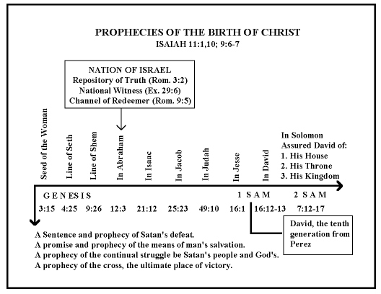

Slide 16
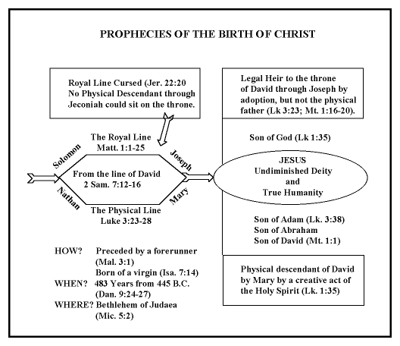

Slide 17
The Suffering Servant - 3

Slide 18
The road to Emmaus - Luke 24 v 25 – 26
“How foolish you are, and how slow of heart to believe all that the prophets have spoken! Did not the Christ have to suffer these things and then enter his glory?” And beginning with Moses and all the Prophets, he explained to them what was said in all the Scriptures concerning himself.

Slide 19
Hebrews 12 v 2
Jesus, who for the joy set before him endured the cross, scorning its shame, and sat down at the right hand of the throne of God.

Slide 20
A world under the control of King Jesus?
Many Christian hymns and songs reflect the Christians’ belief that this will happen in one way or another.
Yet this messianic hope seems as far off as ever in today’s world.
3. Is this an indication of the irrelevance of Christianity?
4. Is this merely a spiritual concept, divorced from the reality of the present world?

Slide 21
Different millennial ideas
Post-millennial. Through revival and outpourings of the Holy Spirit Christianity will conquer the world, and then will hand world government over to Jesus at His coming.
Amillennial. Generally dismissing the idea of Jesus as king of the world in any physical and political way; his kingship in this age is spiritual, operating through Christian influence in all areas of human society and endeavour. Rather, he will be king over His creation in the future eternal realms.
Pre-millennial. This is based on a literal and full understanding of the whole scripture, especially unfulfilled prophecy.

Slide 22
Premillennial principles of the Kingdom
In the Church age the Kingdom of God is spiritual, in the lives of all true Christians – Luke 17 v 20 – 21. The Church age is the time of the preparation of the King’s bride.
The dispensational view of history shows there is another age still to come, the Kingdom age – Luke 24 v 25 – 27 & Acts 1 v 6 – 7.
The Kingdom age is firmly centred around God’s covenant with Israel – Isaiah 9 v 6 – 7. The church is not the “new Israel” – God is faithful to all His promises!!
Recent history shows an amazing preparation for the change of era, and we await the preliminary steps – the Rapture, the Tribulation, the glorious return of Jesus.

Slide 23
Biblical prophecies about the Lord’s reign
The King’s arrival will be visible to all – Matthew 24 v 30, Philippians 2 v 10 – 11.
A time of Earth’s cleansing – Daniel 12 v 11 – 12, Zechariah 14 v 6 – 7, Revelation 19 v 17 – 21.
Israel will have her King at last – Psalm 72.
Universal political harmony – Isaiah 2 v 1 – 4.
Universal economic harmony – Isaiah 11 v 1 – 5.

Slide 24
6. Universal environmental harmony – Isaiah 11 v 6 – 9, Romans 8 v 19 – 22.
7. Long lifespans for humans – Isaiah 65 v 17 – 25.
8. Universal spiritual harmony – Zechariah 14 v 9, Philippians 2 v 9 – 11.
9. An end to imperialism, which originated in Babylon – Daniel 2 v 36 – 45, Revelation 18.
10. A much better and happier society worldwide for 1000 years until the end of time – Revelation 20 v 1 – 3, 21 v 1 & 5 (new is kainos, renewed, not neos, brand-new).

Slide 25
What about us?
Throughout the Kingdom age, as the Bride of Jesus we will be in our eternal, resurrected and glorified bodies. Although the best will be still to come in the eternal realms (Revelation 21 & 22), we will share in the joy of the blessedness of the Kingdom age, the transformation of the planet we love – 1 Corinthians 2 v 9.

